Slide 1

inzva Applied AI Program Week 6
Machine Learning Model Deployment
Duygu Ay
19.02.2022

Slide 2
Today’s Topics
Front end web development with HTML & CSS
Deploying ML models with Flask (Back end)
Serving Flask Applications with uWSGI and Nginx
Docker Containers
Google Cloud Server Setup
Git Basics
Model Deployment with Streamlit and Gradio
Notes:
#filePath = 'myapp/unnamed.jpeg'
#detectImages(filePath)
"""img = cv.imread(imName)
cv.imshow('Detected image: ',img)
cv.waitKey(0)
cv.destroyAllWindows()"""
"""cv.imshow('Detected image: ',f_img)
key=cv.waitKey(1)
if key==27:
break
cap.release()
cv.destroyAllWindows()"""

Slide 3
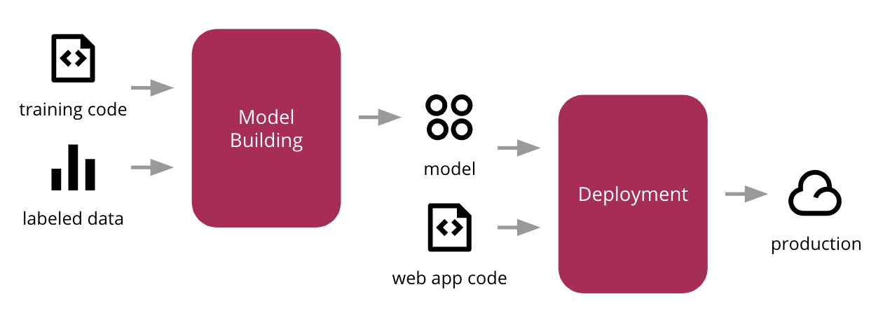
What is Deployment?
Deployment is the method by which you integrate a machine learning model into an existing production environment to make practical business decisions based on data.

Slide 4
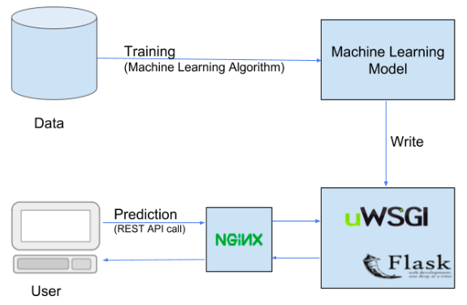
Deploying with Flask and Serving Web App with uWSGI and Nginx

Slide 5

ML Model: Object Detection
Pre-trained tf models used.
Have 90 labels.
Detecting objects in image and video.
Notes:
cv2 waitkey() allows you to wait for a specific time in milliseconds until you press any button on the keyword. It accepts time in milliseconds as an argument.

Slide 6
Front end Web Development with HTML & CSS What is HTML?
Hyper Text Markup Language
NOT a programming language
Markup language for creating webpages and documents
Building blocks of the web
Does not need a web server
Files must end with the .html extension
Runs in a web browser
index.html is the root/home page of a website
http://something.com : loads index.html file
http://something.com/about : loads about.html file
Notes:
Show front end of a website : inspect
CSS ve HTML’I source’dan görebilirsiniz.
Metin işaretleme dili

Slide 7
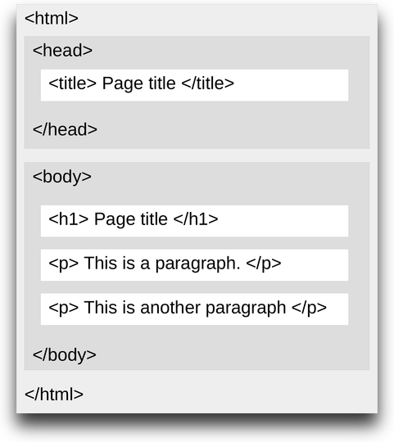
HTML Page Structure
Element names surrounded by angle brackets.
Normally come in pairs.
End tag is same but with a forward slash.
Notes:
Head kısmı tab da çıkan görüntü
Window > tile window left ve diğerine çift tıkla

Slide 8
Tags in HTML
The <nav> tag defines a set of navigation links.
The <a> tag defines a hyperlink, which is used to link from one page to another.
The <div> tag defines a division or a section in an HTML document.
The <br> tag inserts a single line break.
<meta> tags always go inside the <head> element, and are typically used to specify character set, page description, keywords, author of the document, and viewport settings.
The <input> tag specifies an input field where the user can enter data.
For other tags visit https://www.w3schools.com/tags/.
Notes:
Comment nasıl yapılır <!---->

Slide 9
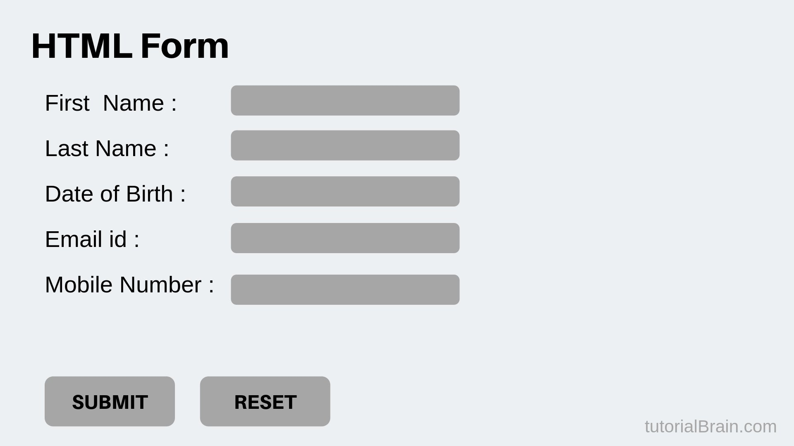
Creating Forms
Notes:
Action özelliği form verilerinin nereye gönderileceğini tanımlar.
the name attribute is used for posting to e.g. a webserver. The id is primarily used for css (and javascript). Suppose you have this setup:
<input id="message_id" name="message_name" type="text" /> in order to get the value with PHP when posting your form, it will use the name-attribute, like this:
$_POST["message_name"];
The id is used for styling, as said before, for when you want to use specific css.
#message_id { background-color: #cccccc; }
Anlat hazırladığını sonra css file olmadan göster.

Slide 10
What is CSS?
Cascading Stylesheets
NOT a programming language
Styling language
Used for website layout and design

Slide 11
Methods for Adding CSS
Inline CSS: Directly in the html element. (not preferrable!)
Internal CSS: Using <style> tags within a single document.
External CSS: Linking an external .css file.

Slide 12
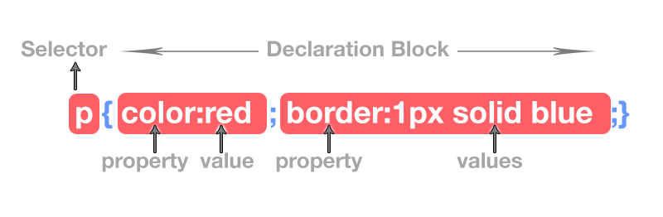
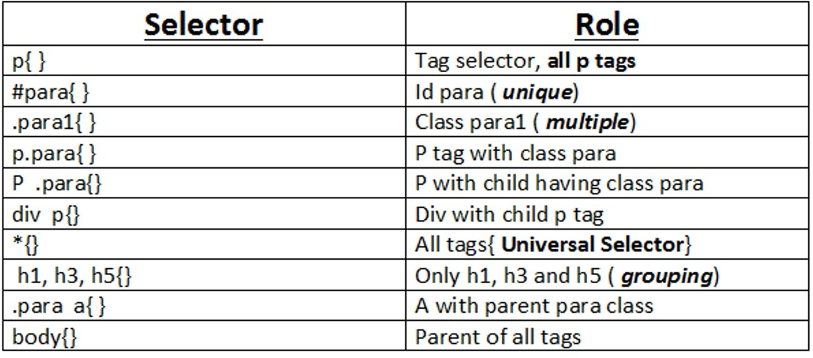
CSS Selectors
Notes:
Selector types
P tagine ait class para.
multipart/form-data is one of the value of enctype attribute, which is used in form element that have a file upload

Slide 13
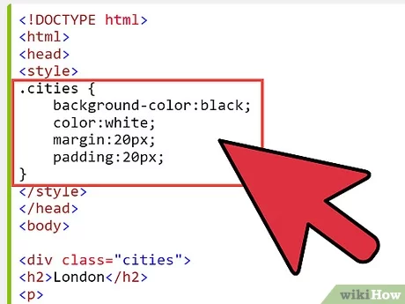
Creating Classes in CSS

Slide 14

Deploying ML models with Flask (Back end) What is Flask?
Flask is a web framework, it’s a Python module that lets you develop web applications easily.
It is a lightweight micro framework.
It enables web application developers to write applications without worrying about low-level details such as protocol, thread management, and so on.

Slide 15
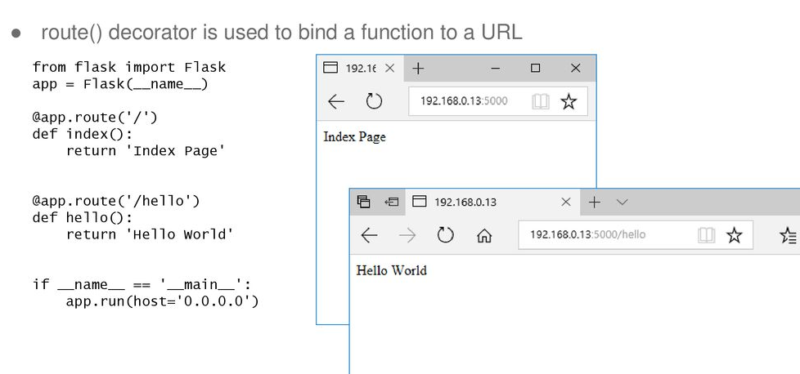
Routing

Slide 16
Debug Mode
The debugger allows executing arbitrary Python code from the browser.
If we write app.run() and our application is under development, it should be restarted manually for each change in the code. So for every change in the program we have to restart the server and try to observe the changes.
To overcome this problem, enable debug support. The server will then reload it self if the code changes.

Slide 17
Link to HTML File
render_template() is used to generate output from a template file that is found in the application's templates folder.

Slide 18
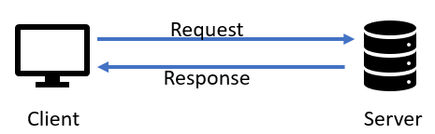
Request
To access the incoming data in Flask, you have to use the request object.
The request object holds all incoming data from the request.

Slide 19
HTTP Methods
The method is the type of action you want the request to perform and is sent from the client to the server on every request.
GET - Used to fetch the specified resource. It is used to return data at a specified resource/location.
Returning text
Rendering templates
POST - Used to create new data at the specified resource.
POST requests should be used to create NEW resources (New users, devices, posts, articles, datasets etc..)
PUT, PATCH, DELETE
Notes:
Flask routes listen for GET requests by default, so we must implicitly instruct them to listen for anything other than GET.
In the example below, we've passed methods=["POST"] to the @app.route() decorator, meaning this route will ONLY respond to POST requests:
Get: sending client an information . Default. Insecure way.
Client servera herhangi bir request gönderdiğinde bu gönderdiği requestin action çeşitidir.
GET - Belirtilen kaynağı getirmek için kullanılır
POST - Belirtilen kaynakta yeni veri oluşturmak için kullanılır
PUT - Belirtilen kaynakta yeni veriler oluşturmak veya mevcut verileri değiştirmek için kullanılır
PATCH - Belirtilen kaynakta yeni veriler oluşturmak veya mevcut verileri güncellemek/değiştirmek için kullanılır
DELETE - Belirtilen kaynaktaki mevcut verileri silmek için kullanılır

Slide 20
Other files for app
Create __init__.py file (for setting python package)
from flask import Flask
myapp=Flask(__name__,template_folder='templates',static_folder='static:css')
from myapp import main
Create run.py file outsite of app folder
from myapp import myapp
if __name__ == "__main__": myapp.run(debug=True)
Import myapp in flask framework file
from myapp import myapp
Creating requirement.txt
pip install pipreqs
pipreqs ./
Try
python run.py

Slide 21
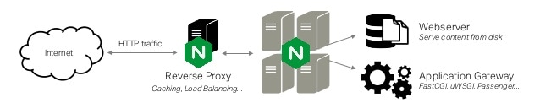
Serve Flask Applications with uWSGI and Nginx on VM Machine What is NGINX?
Nginx is a web server that can also be used as a reverse proxy, load balancer, mail proxy and HTTP cache.
It can handle high http traffic.
It is good at security and cashing.
Notes:
Flask yazdığımız app’i test etmemiz için bize basit bir development server sağlıyordu. Ancak internet ortamında çalışmamızı yayınlamak istiyorsak daha güvenli ve daha güçlü bir web server kullanmamız gerekir. Nginx de en çok kullanılan web serverlardan biridir. Yoğun internet yani http trafiğinle kolayca handle edebilir. Security ve cashing de iyidir. Yani arka tarafta bazı şeyleri çok iyi optimize eder. Fakat nginx aldığı bir requesti doğrudan flask’e iletemez. Çünkü python’ı bilmiyor.

Slide 22
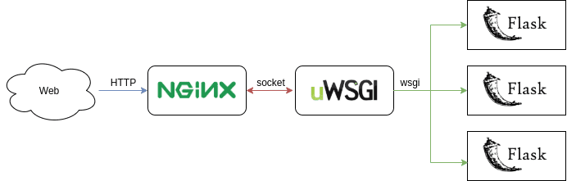
What is uWSGI?
uWSGI is a Web Server Gateway Interface (WSGI) server implementation that is typically used to run Python web applications.
The uWSGI server is responsible for loading your Flask application using the WSGI interface.
Notes:
İşte bu noktada uwsgi’ye ihtiyaç duyuyoruz. Uygulamayı çalışır hale getirebilmek için bir tane ara katmana ihtiyaç duyuyoruz. Web serverlarının ve python web uygulamalarının nasıl haberleşmesi gerektiğini söyleyen bir standard var. Bu wsgi. Açılımı. Web server geçit arayüzü. Bu kuralları uygulamış sunuculardan bir tanesi de uwsgi.

Slide 23
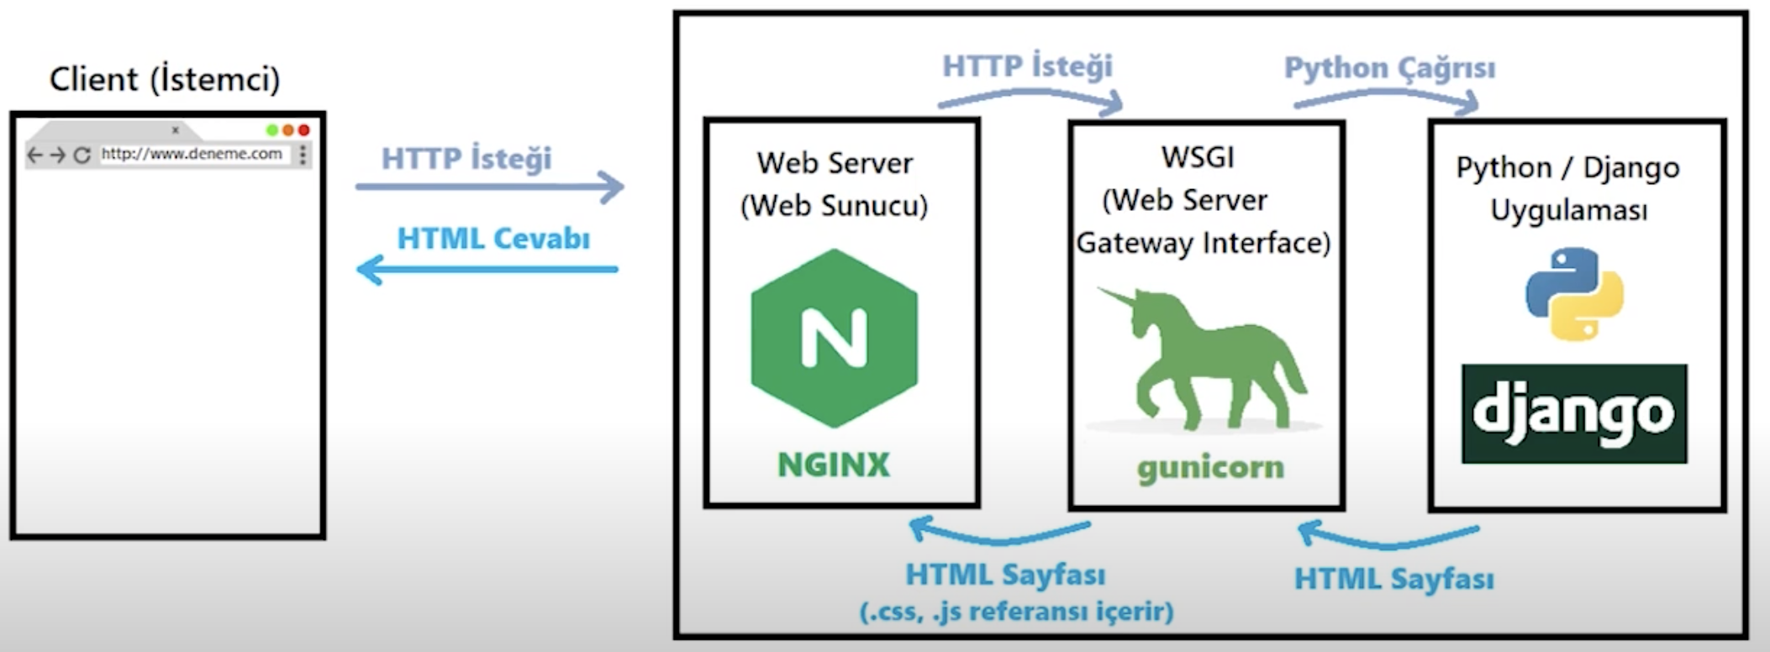


Python / Flask Uygulaması

Slide 24
Creating a uWSGI Configuration File
Create outside of app folder named myapp.ini
[uwsgi]
wsgi-file = run.py
callable = myapp
socket = :8080
processes = 4
master = true
chmod-socket = 660
vacuum = true
die-on-term = true

Slide 25
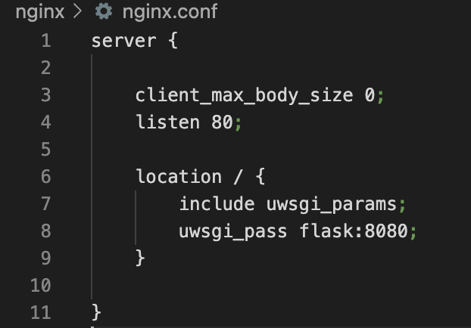
Configuring Nginx to Proxy Requests
Create a nginx.conf file
Notes:
configure Nginx to pass web requests to that socket using the uwsgi protocol.
Next, let’s add a location block that matches every request. Within this block, we’ll include the uwsgi_params file that specifies some general uWSGI parameters that need to be set. We’ll then pass the requests to the socket we defined using the uwsgi_pass directive:

Slide 26
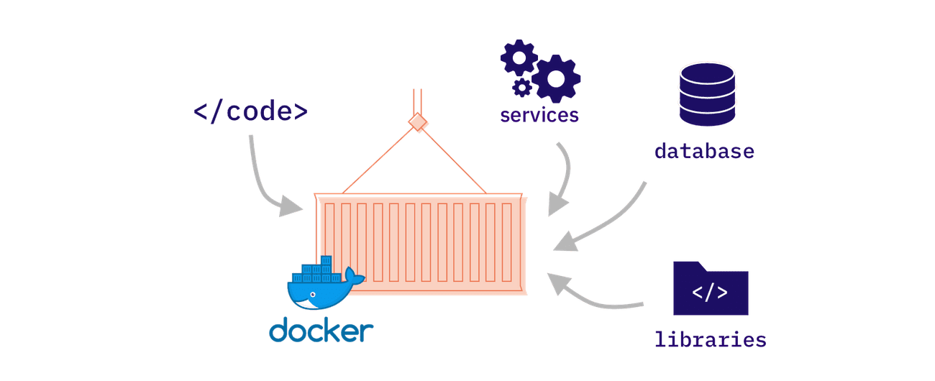
Docker Containers
Docker is a tool designed to make it easier to create, deploy, and run applications by using containers. Containers allow a developer to package up an application with all of the parts it needs, such as libraries and other dependencies, and ship it all out as one package.
Notes:
Let’s say you have three different Python-based applications that you plan to host on a single server (which could either be a physical or a virtual machine).
Each of these applications makes use of a different version of Python, as well as the associated libraries and dependencies, differ from one application to another.
Since we cannot have different versions of Python installed on the same machine, this prevents us from hosting all three applications on the same computer.
The Solution
Let’s look at how we could solve this problem without making use of Docker. In such a scenario, we could solve this problem either by having three physical machines, or a single physical machine, which is powerful enough to host and run three virtual machines on it.
Both the options would allow us to install different versions of Python on each of these machines, along with their associated dependencies.
Irrespective of which solution we choose, the costs associated with procuring and maintaining the hardware are quite expensive.
Now, let’s check out how Docker could be an efficient and cost-effective solution to this problem.
To understand this, we need to take a look at how exactly Docker functions.

Slide 27
Installing Docker and Docker-compose
https://docs.docker.com/engine/install/
https://docs.docker.com/compose/install/
File structure:
Create two separate folders named flask and nginx
Put your flask app in flask folder

Slide 28
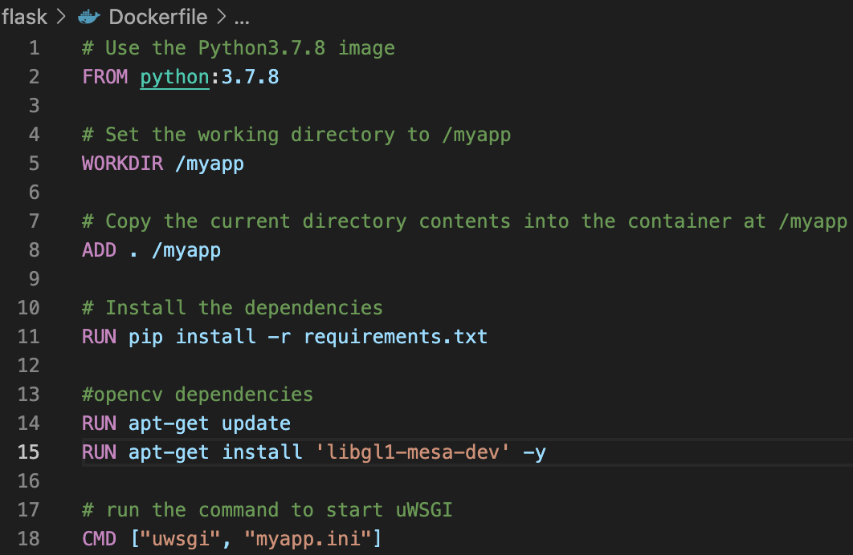
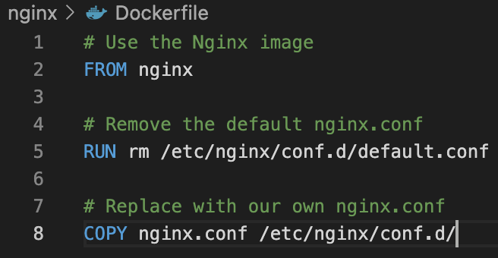
Build Docker Images
In flask folder:
Make sure you have requirements.txt file
Create a file named “Dockerfile”
In nginx folder:
Create a file named “Dockerfile”
Notes:
Build the image in the working dir
docker image build –t myapp .
Run the container
docker run –p 5000:5000 –d myapp
Stop the container
docker stop ”docker_id”
remove any stopped containers, unused volumes and networks, and dangling images.
docker system prune

Slide 29
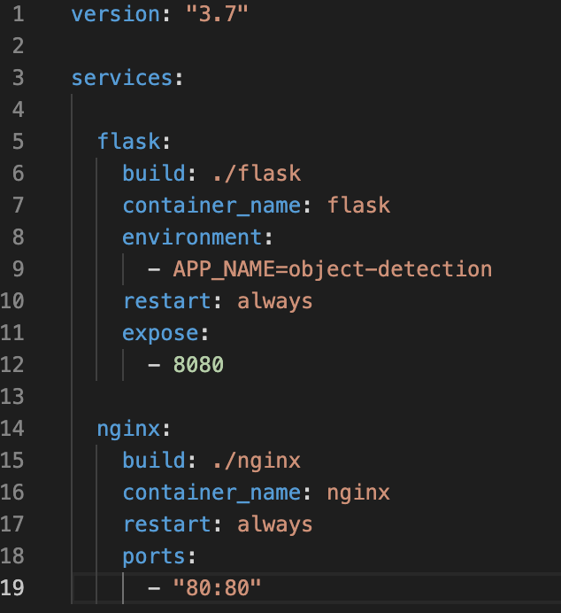
Create docker-compose.yml file
Outside of flask and nginx folders

Slide 30
Run the Docker Container
Start docker engine
to build and create the containers:
docker-compose build
to start the containers in detach mode:
docker-compose up –d
Open up http://127.0.0.1/ or http://localhost/ to see your Flask app in action.
to list any running images:
docker-compose images
to stop services:
docker-compose stop
to down services:
docker-compose down

Slide 31
Google Cloud (GCP) Server Setup
Create project
Create VM instance from Compute Engine
Create SSH key on local computer
ssh-keygen -t rsa -f ~/.ssh/”folderName” -C “username”
cd ~/.ssh and cat “foldername”.pub
Copy and past the key to VM instance by editing.
Connect server from your local computer
ssh –i ~/.ssh/”folderName” “username”@[IP address of VM instance]
Or
ssh “username”@[IP address of VM instance]
Notes:
eğer hata verirse nano config yap (son şeyi kopyala)
Depending of region memory and machine type change
folderName: ssh key will be stored in there
There will be private and public key(.pub)
Ubuntu 18.04
Connect from vscode
Command palette > remote ssh connect host
Open folder home>duyuay

Slide 32
Installing Docker in GCP VM instance
sudo apt update
sudo apt install docker.io
Install docker-compose:
https://phoenixnap.com/kb/install-docker-compose-ubuntu
Move your folders to VM instance
If you want to copy folders from terminal, check link:
https://www.golinuxcloud.com/ssh-copy-folder-local-to-remote-server-linux/
To run the docker-compose on VM instance, add sudo command at the beginning of usual commands
Open http://[IP]
Notes:
Tam copy etmesini bekle

Slide 33
Push the Project to GitHub
Creating a repo in Github
Check for Git Version, If not installed download the git according to OS of your system.
git --version
Clone the repo you created with ssh link
git clone “repo link”
Copy your files to cloned empty repo or move
Committing files into the git repo.
cd ‘your repo name’
git add .
git commit -m "First Commit”
Final push
git push origin ‘branch_name’
https://hackernoon.com/step-by-step-guide-to-push-your-first-project-on-github-fec1dce574f
Notes:
Branch name: master
env1/bin/python -m pip freeze > requirements.txt
env2/bin/python -m pip install -r requirements.txt
Switch branch:
git checkout main
mv ./’filename’ ./’deployment’
cd deployment
Login
git config global user.emal ‘github user email’
git config global user.name ‘github user name’
Developer settings > personal access tokens > generate a personal access token > add note > click repo > admin: repo hook > copy token > enter token instead of password
Ls –la : to see hidden files > remove git file from myapp folder
Rm –rf ‘filename’: to remove file
By using the ssh protocol, we can connect and authenticate to remote servers and services. With ssh keys we can connect to GitHub without supplying our username and password at each visit with the help of passphrase. In HTTPS method, you will need to fill our username and password at every visit, which will be very inconvenient.
Move: mv ./myapp.ini ./deployment
https://www.youtube.com/watch?v=WgZIv5HI44o&ab_channel=SyntaxByte

Slide 34

Streamlit
Streamlit is an open-source python framework for building web apps for Machine Learning and Data Science.
The best thing about Streamlit is it doesn’t require any knowledge of web development. If you know Python, you’re good to go!
A few demos in streamlit
pip install streamlit
streamlit hello
Notes:
https://www.analyticsvidhya.com/blog/2021/06/build-web-app-instantly-for-machine-learning-using-streamlit/
https://towardsdatascience.com/streamlit-101-an-in-depth-introduction-fc8aad9492f2

Slide 35
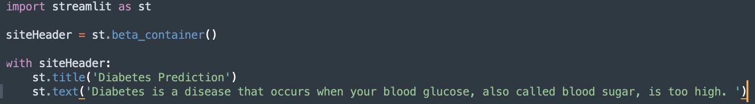
Creating Containers
streamlit run main.py
Notes:
Rerun vs always rerun

Slide 36
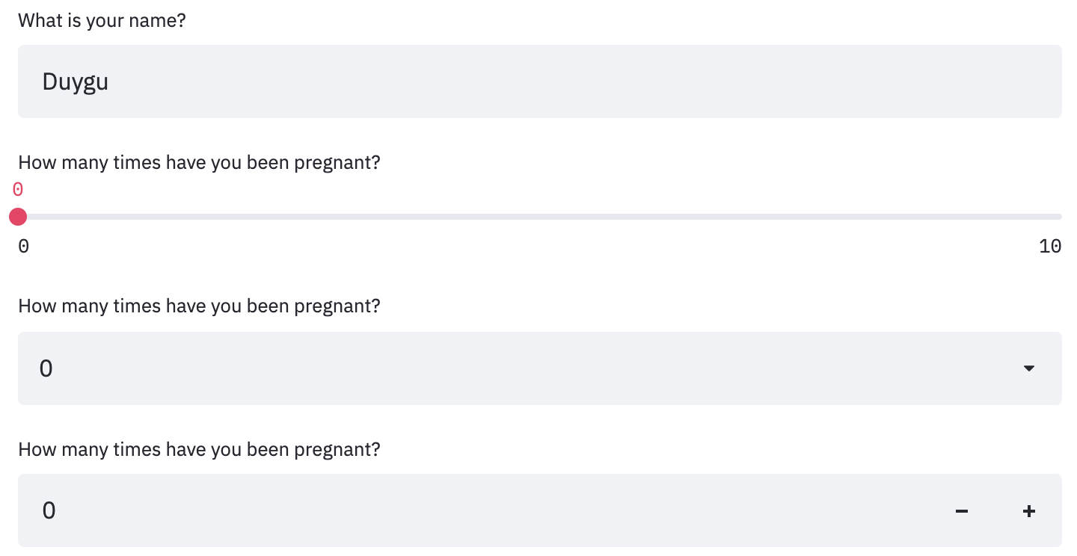
Collecting User Input
Text input
Slider
Drop down menu
Number input
Notes:
import streamlit as st
import joblib
model = joblib.load('model')
site_header = st.beta_container()
with site_header:
st.title('Diabetes Prediction')
st.text('Diabetes is a disease.')
with st.form(key='form'):
input_text = st.text_input('What is your name?')
slider = st.slider('AGE', min_value=0, max_value=100, value=0, step=1)
drop_down = st.selectbox('Education level', options =['high school', 'college', 'master'])
number = st.number_input('Age', min_value=0, max_value=100, value=0, step=1)
submitted = st.form_submit_button('Submit')
if submitted:
st.text(input_text)

Slide 37
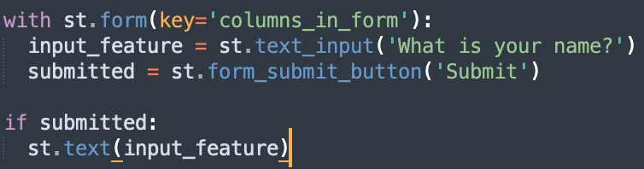
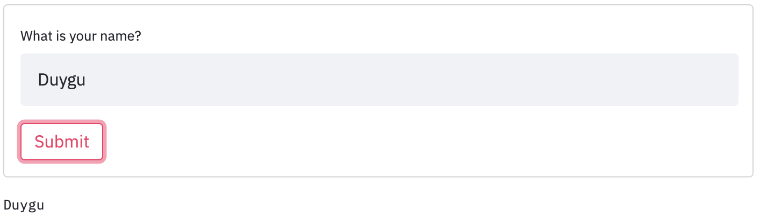
Creating Forms

Slide 38
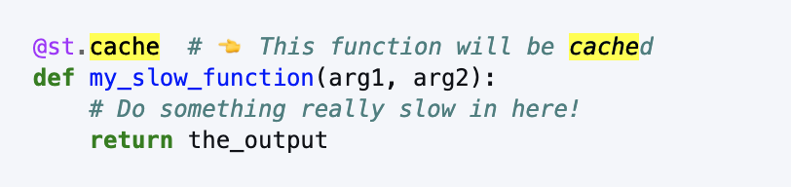
Optimizing App’s Run Time
Every time the user changes an input, the whole application runs from the beginning.
If your application includes a lot of calculations, works with big amounts of data or does calls to a database to retrieve data, your application will quickly become too slow to interact with.
As a solution, the streamlit team developed “caching”.

Slide 39
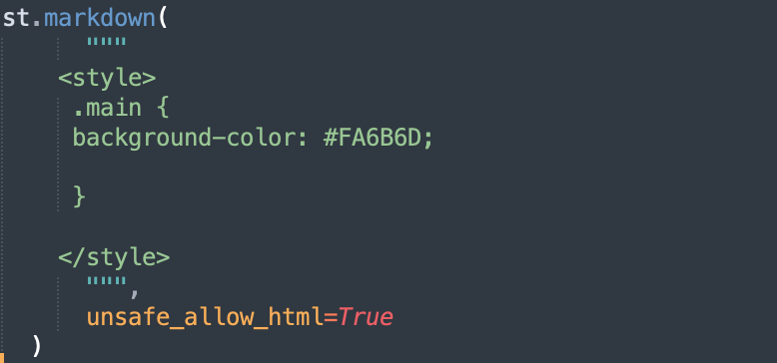
Styling

Slide 40
Deploying a Streamlit App
Sign in with your github account to streamlit.io/sharing.
Create a github repo.
Make sure it is a public repo and it has a requirement.txt file.
Sign in to streamlit.io
Make sure you sign up with e-mail in your github account.
New app > Deploy
Notes:
Pip install pipreqs
Pipreqs ./

Slide 41

Gradio
Gradio is the fastest way to demo your machine learning model with a friendly web interface so that anyone can use it, anywhere!
It is good to use gradio to build MVP for your startup quickly.
It is good to use gradio to test your ML models quickly and share with your team.
gradio.app
pip install gradio
gradio.app/getting_started/
Great tutorial videos: youtube/gradio.tutorial
Notes:
https://gradio.app/docs/?ref=https://githubhelp.com#interface

Slide 42
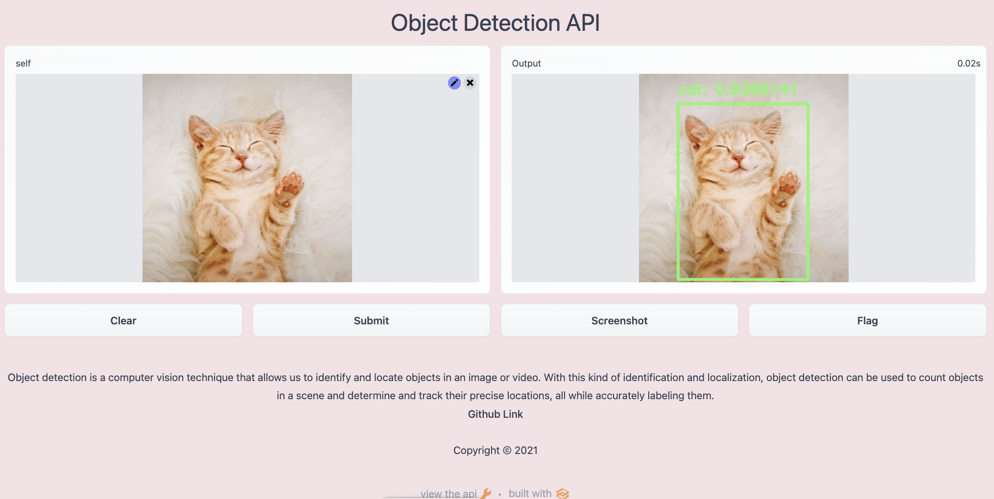
Build the Object Detection App with Gradio

Slide 43
How to Deploy the Gradio app Permanently?
Create Hugging Face account if you don’t have: huggingface.co/join
Confirm your email address
Create a new space
Create the app.py file right in your browser.
Upload your other related python file (models, object detection class)
Upload your requirement.txt file
If you have Debian dependencies, upload packages.txt file
Wait until “Building” is done. You will see “Running”.
You can also see the logs.
You can share your app URL with everyone!
https://huggingface.co/spaces/dyguay/object-detection-api

Slide 44
Thank you!

